Slide 1


INTERNSHIP PRESENTATION
ON
“CESC”
BY
RAKSHITHA G
4GW19EE030
Under the Guidance of
Internal Guide External Guide Smt. SMITHA S K LOKESH P
Assistant Professor Asssistant Exeutive Engineering
Dept. of EEE, GSSSIETW CESC, Mysore
Department of Electrical & Electronics Engineering

Slide 2
CONTENTS
ABOUT THE COMPANY
INTRODUCTION
OBJECTIVES
TYPES & TESTING OF METERS
TESTING OF TRANSFORMERS
BUDGET ALLOCATION AND VENDOR APPROVAL PROCESS
CALL CENTER
CESC APP
CONCLUSION

Slide 3

ABOUT THE COMPANY
The CESC company provides electricity to five districts of Karnataka
Districts under the jurisdiction of CESC are :
Mysuru
Chamarajanagar
Mandya
Kodagu

Slide 4
INTRODUCTION
CESC Limited is a socially responsible company, which aims at contributing towards the up liftment of the poor and underprivileged residing in its area of operation, along with its focus on generating profits, protecting the interests of investors and shareholders, and serving the customers with utmost satisfaction.

Slide 5
OBJECTIVES
To understand the importance of electric energy and utilizing it in the efficient way by using latest technologies.
To evaluate the strength of existing system to control power theft and punishment.

Slide 6
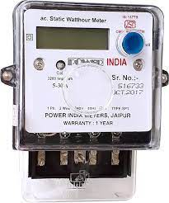
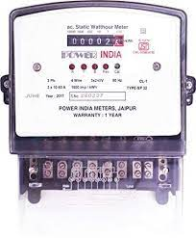
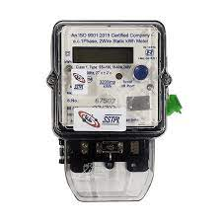
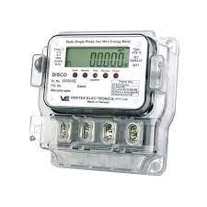
METERS
1.Electromechanical Type Induction meter
(a) Single phase (b) Three phase
2.Electronic Energy Meter 3.Smart Meter

